Slide 1
Chatbots Development with Amazon Lex
Chatbot Development with Amazon Lex
Integrating Amazon Lex with AWS Lambda
Twilio and Website Integration
Response Cards with Chatbot
Shahzaib Hamid
AI Sciences Instructor

Slide 2

Module Overview
Chatbot Development with Amazon Lex
Connecting Amazon Lex with Amazon Lambda
Integrating Twilio with Amazon Lex Chatbot
Website Integration
Response Cards
Overview
Process
Hands-on
Overview
Process
Hands on
Overview
Process
Hands-on
Overview
Process
Hands on
Overview
Process
Hands on

Slide 3
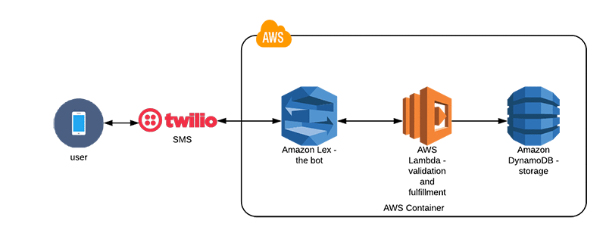

Chatbot Development with Amazon Lex
The Process Includes
We are here

Slide 4
Chatbot Development with Amazon Lex
Steps to Create Basic Chatbot with Amazon Lex
Amazon Lex
Bot Configuration
IAM Permissions
Language Selection
Intent
Slot
Context
Configuration
Build
Test

Slide 5
Connecting Amazon Lambda with AWS Lex
Recall the Previous Diagram
We are here

Slide 6
Connecting Amazon Lambda with AWS Lex
Steps Include
Amazon Lambda
Create basic Function
Update Lambda Function
Build
Test

Slide 7
Integrating Twilio with Amazon Lex Chat Bot
Recall the Previous Diagram
We are here

Slide 8
Website Integration with Amazon Lex Chat Bot
Website Integration
Chat Bot Integration
Chat Bot Demo
Few Modifications
Account Setup

Slide 9
Add Response Cards in Amazon Lex Chatbot
The Process includes
Slot Upgradation
Chatbot Building
Chatbot Demo
Card Setup

